Slide 1

Optimization Techniques for Recommendation System
Syed Inshal Raza Naqvi
Zain Mudassar
Pradnya Nimbekar

Slide 2
Need of Recommendation Systems
Take correct decisions
Increase sales
Retain the customers
Enhance the shopping experience

Slide 3
The Solutions
Two methods for the recommendation system:
Content-Based
Collaborative filtering
Rating Oriented
Ranking Oriented

Slide 4
Why Ranking Based Algorithm?
Unavailability of rating data
Implicit feedback

Slide 5
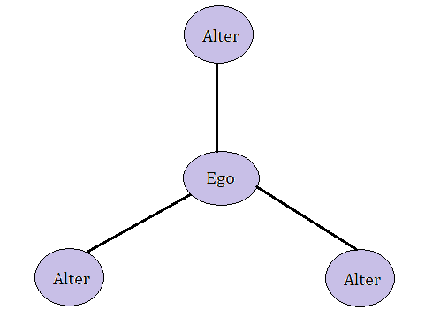
Common Approach: Optimized Approach:
Neighbor-based collaborative filtering
Graph based recommendation system with Social Network Analysis based on co-purchase data
Constructing a graph representing the data
Making recommendations by analyzing the data
Ego Network

Slide 6
Dataset :
Source: https://snap.stanford.edu/data/amazon-meta.html
The dataset contains product metadata and review information about 548,552 different products. For each product the following information is available:
Product ID: numeric values (0,1,2….,548,551)
ASIN: Amazon Standard Identification Number is a 10-character alphanumeric UID assigned by Amazon for product identification.
Title: Name of the Product.
Group: Product type, could be books, music CDs, DVDs and VHS video tapes.
SalesRank: Representation of the sales of that product compared to the others in its category.
Similar: ASINs of co-purchased products i.e., people who buy A also buy B.
Categories: Gives the specification of the product’s category hierarchy, e.g., genre etc. (separated by |, category id in [ ]).
Reviews: Total number of reviews and average rating

Slide 7
Graph Structure:
Nodes: ASINs
Edges: Relation- two ASINs had an edge if they were co-purchased.
Edge weight: Based on the category similarity of the products
DegreeCentrality: Count of the number of neighbors a node has.
ClusteringCoeff: A measure of the degree to which nodes in a graph tend to cluster together.

Slide 8
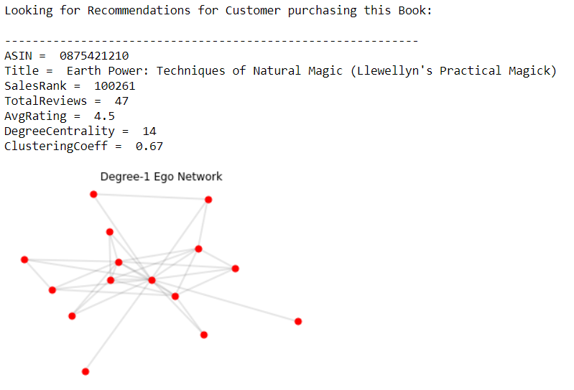
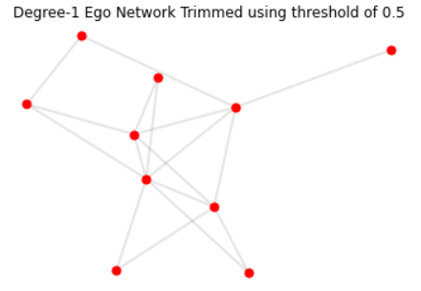
Implementation:
Preprocessing
1. Read data from amazon-meta.txt and populate amazon products nested dictionary.
2. Create books-specific dictionary exclusively for books.
3. Remove any copurchased items from copurchase list if we don't have metadata associated with it.
4. Create a product copurchase graph for analysis where the graph nodes for product ASINs and graph edge exists if two products were copurchased, with edge weight being a measure of category similarity between ASINs
5. Get Degree Centrality and clustering coefficients of each ASIN and add it to amazonBooks metadata
6. Write amazonBooks data to file and then write copurchaseGraph data to file
Ego Network

Slide 9
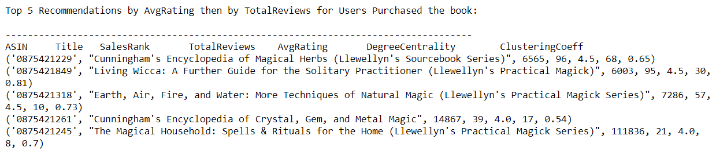
Implementation
Taking Recommendations:

Slide 10
Conclusion
Graph based approach in ranking algorithms
The proposed graph structure has been mainly used here for finding the closeness between users and items.

Slide 11
Thank You!

